Slide 1
Topic: Compound Interest (sammensatte interesse/andel)
EQ: How do I calculate the final amount if compounded daily?

Slide 2
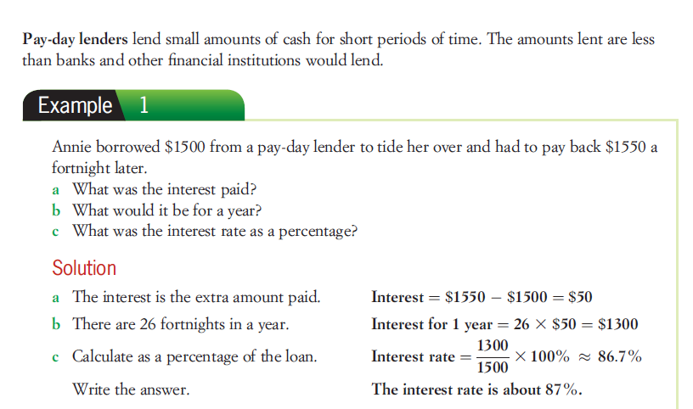

Slide 3
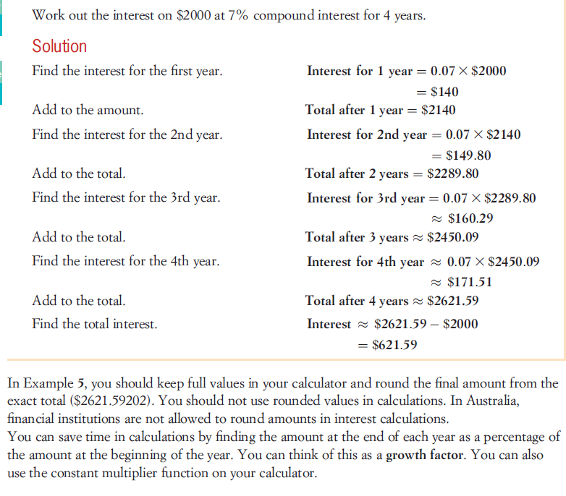

Slide 4
Compound Interest
Simple interest is interest paid only on the principal
Compound interest is interest paid not only on the principal (rektor/penge), but also on the interest (interesse/andel) that has already been earned.

Slide 5
Compound interest formula
Compounded Annually (forværret årligt):
Compounded n times a year:
A = the final dollar value P = principal r = interest rate per period of compounding
t = time n = number of periods I = interest earned

Slide 6
Period | Interest Credited | Times Credited per year | Rate per compounding period
Annual | year | 1 | r
Semi-annual | 6 months | 2
Quarterly | quarter | 4
Monthly | month | 12
Daily | Day | 365

Slide 7
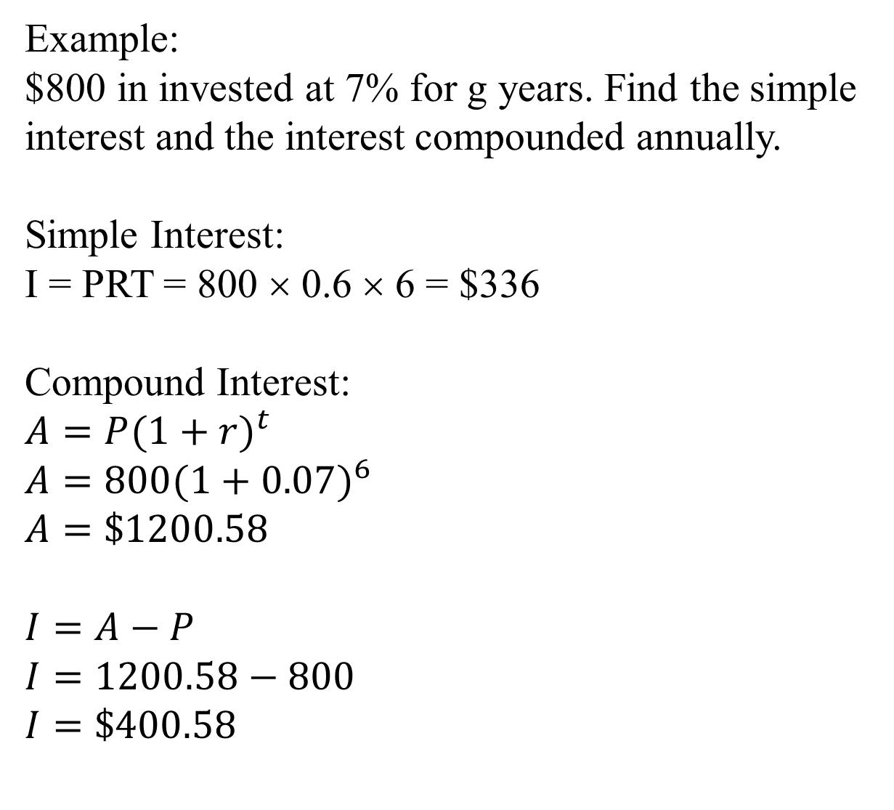
6
Invested - investeret

Slide 8
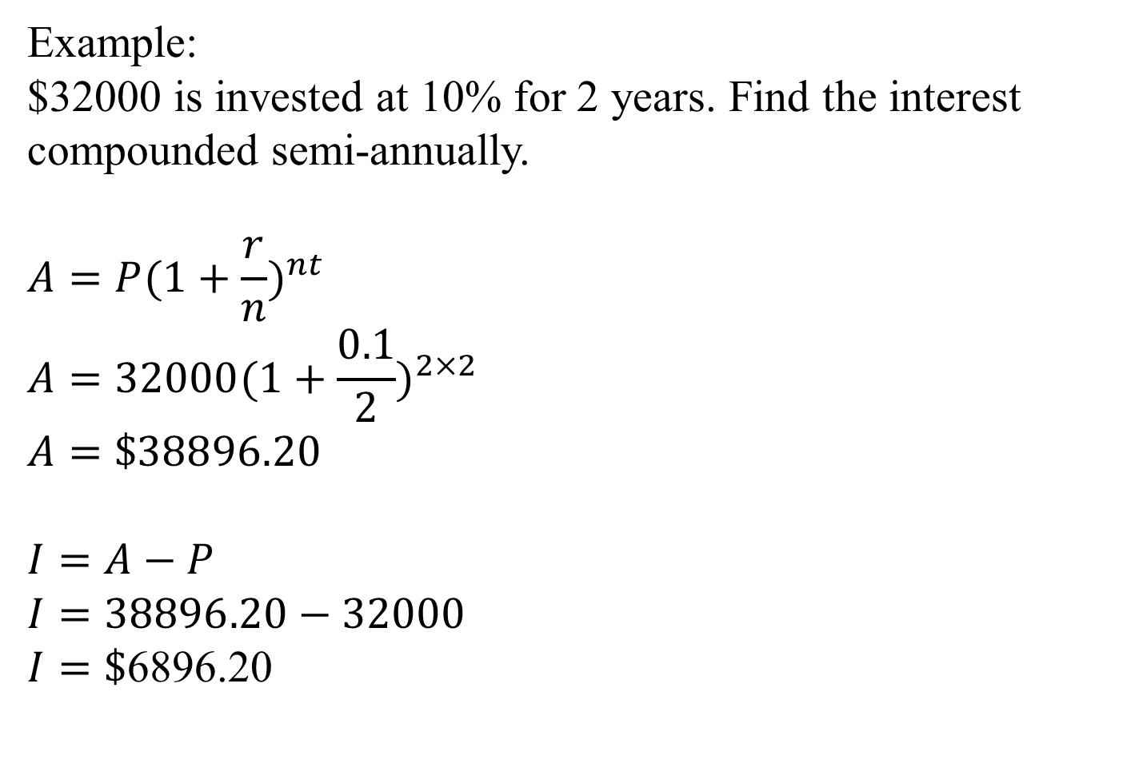
Semi-annually - Halvårligt

Slide 9
